Slide 1
Chapter Two
HTML Forms and PhP

Slide 2
Sending form data
An HTML form on a web page is nothing more than a convenient user-friendly way to configure an HTTP request to send data to a server.
This enables the user to provide information to be delivered in the HTTP request.
The <form> element defines how the data will be sent.
All of the <form> attributes are designed to let you configure the request to be sent when the form is submitted.
The action and method attributes are the most important as they define where to send the data and how to send it.

Slide 3
The action attribute
The action attribute defines where the data gets sent.
Its value must be a valid relative or absolute URL.
Example, the data is sent to an absolute URL: https://example.com
<form action="https://example.com">…</form>
Example, a relative URL where the data is sent to a different URL on the same origin
<form action="/somewhere_else">…</form>
If the action attribute isn't provided, the data will be sent to the URL of the page containing the form, which is the current page.
Notes:
Note: It's possible to specify a URL that uses the HTTPS (secure HTTP) protocol. When you do this, the data is encrypted along with the rest of the request, even if the form itself is hosted on an insecure page accessed using HTTP. On the other hand, if the form is hosted on a secure page but you specify an insecure HTTP URL with the action attribute, all browsers display a security warning to the user each time they try to send data because the data will not be encrypted

Slide 4
The action attribute cont’d
The action value should be a file on the server that can handle the incoming data, including ensuring server-side validation.
The server then responds, generally handling the data and loading the URL defined by the action attribute, causing a new page load
or a refresh of the existing page, if the action points to the same page
The method attribute is what determines how the data is sent
Notes:
The names and values of the non-file form controls are sent to the server as name=value pairs joined with ampersands.

Slide 5
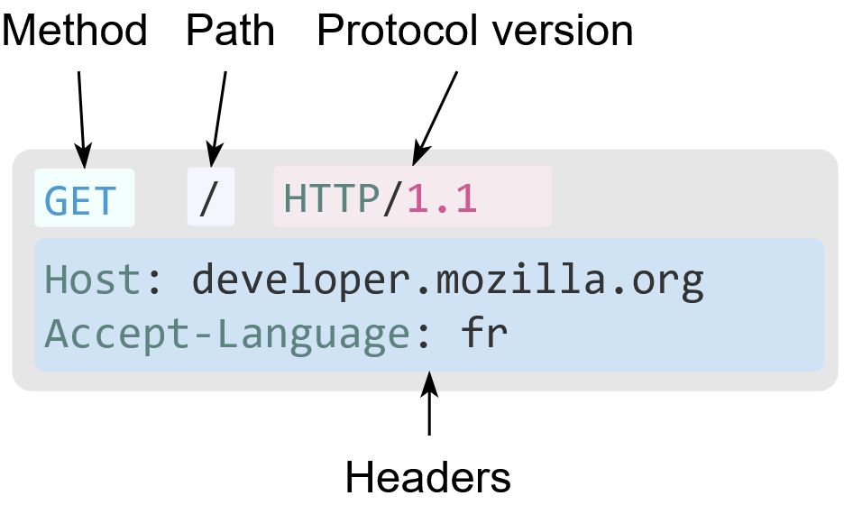
The method attribute
Despite the HTTP protocol offering various request methods such as GET, POST, PUT, DELETE, and PATCH,
HTML forms are designed to support only GET and POST.
This limitation comes from the original purpose of HTML forms, which was to facilitate simple data submission and retrieval in web applications.
An example HTTP request
Notes:
HTTP Requests consist of the following elements: An HTTP method, usually a verb like GET, POST, or a noun like OPTIONS or HEAD that defines the operation the client wants to perform.
The path of the resource to fetch; the URL of the resource stripped from elements that are obvious from the context,
for example without the protocol (http://), the domain or the TCP port
The version of the HTTP protocol
Optional headers that convey additional information for the servers.
A body, for some methods like POST, similar to those in responses, which contain the resource sent.

Slide 6
PHP Form Handling
PHP can handle data submitted through HTML forms
PHP uses the superglobals $_GET and $_POST to collect form-data
Some predefined variables in PHP are "superglobals", which means that they are always accessible, regardless of scope
$_GET is an array of variables passed to the current script via the URL parameters.
$_POST is an array of variables passed to the current script via the HTTP POST method.

Slide 7
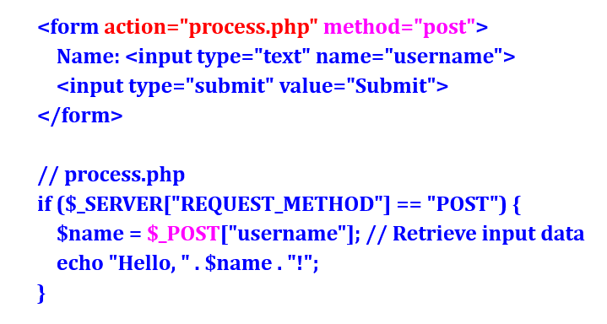
Example

Slide 8
PHP $_POST
$_POST contains an array of variables received via the HTTP POST method.
There are two main ways to send variables via the HTTP Post method:
HTML forms
JavaScript HTTP requests
A HTML form submits information via the HTTP POST method if the form's method attribute is set to "POST“
When a user clicks the submit button, the form data is sent to a PHP file specified in the action attribute of the <form> tag.
In the action file we can use the $_POST variable to collect the value of the input field.

Slide 9
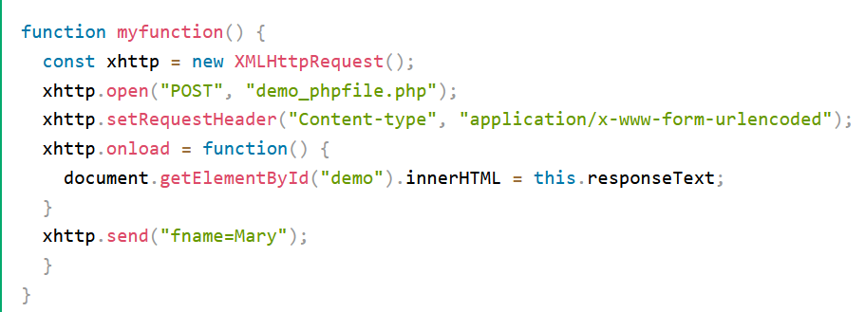
$_POST in JavaScript HTTP Requests
Notes:
The code above will:
Intiate a HTTP request
Set the HTTP method to POST
Set a valid request header
Create a function to execute when the request is done
Send the HTTP request with a variable fname set to Mary

Slide 10
PHP $_GET
$_GET contains an array of variables received via the HTTP GET method.
There are two main ways to send variables via the HTTP GET method:
Query strings in the URL
HTML Forms
A query string is data added at the end of a URL.
Example,
<a href="demo.php?subject=PHP&web=W3schools.com">Test $GET</a>
everything after the ? sign is part of the query
In the PHP file we can use the $_GET variable to collect the value of the query string
Echo $_GET['subject'] ;

Slide 11
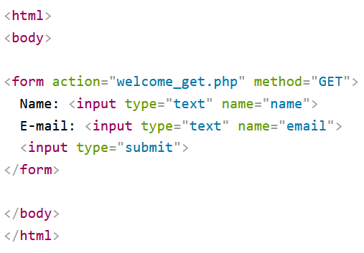
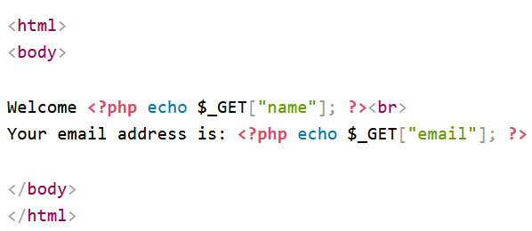
$_GET in HTML Forms
A HTML form submits information via the HTTP GET method if the form's method attribute is set to "GET".

Slide 12
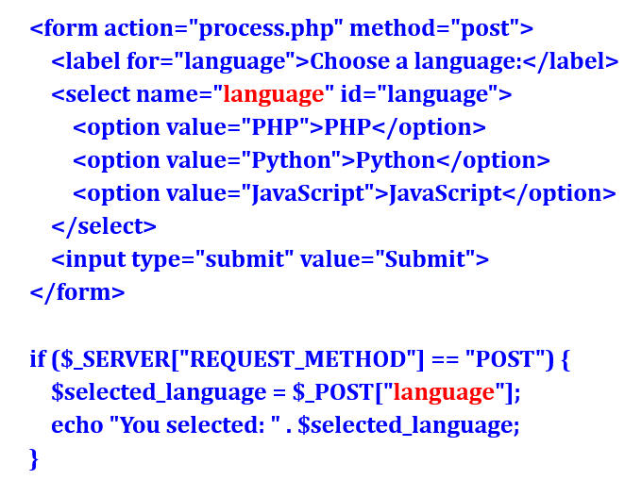
Handling Different Input Types
Dropdown Selection using <select>

Slide 13
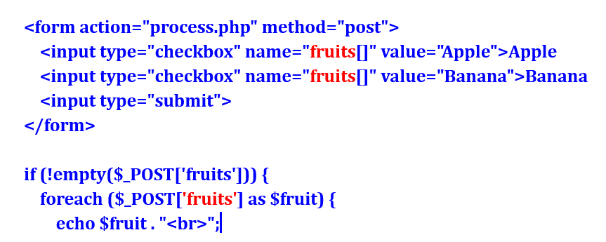
Handling Different Input Types
Checkboxes (Multiple Selections)

Slide 14
Takeaway questions
Create a form that accepts a name and displays "Welcome, [Name]!" after submission.
Create a form with a dropdown list of three programming languages. When the user submits the form, display the selected language.

Slide 15
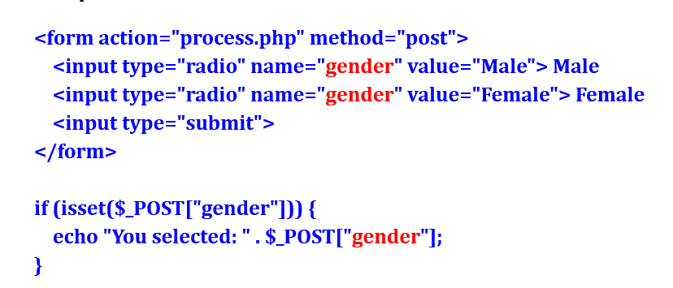
Handling Different Input Types
Radio Buttons (Single Selection)
Notes:
isset($_POST["gender"]) ensures that the user selected an option before displaying it.

Slide 16
Takeaway questions
Create a form with three checkbox options (HTML, CSS, PHP). Display the selected options after submission.
Create a simple login form with username and password fields. Validate that both fields are longer than 5 characters
Build a contact form that takes name, email, phone number and message. Please check if the required fields are filled using php. below is the screenshot of the work you need to do.
The code should be one single contact.php file.

Slide 17
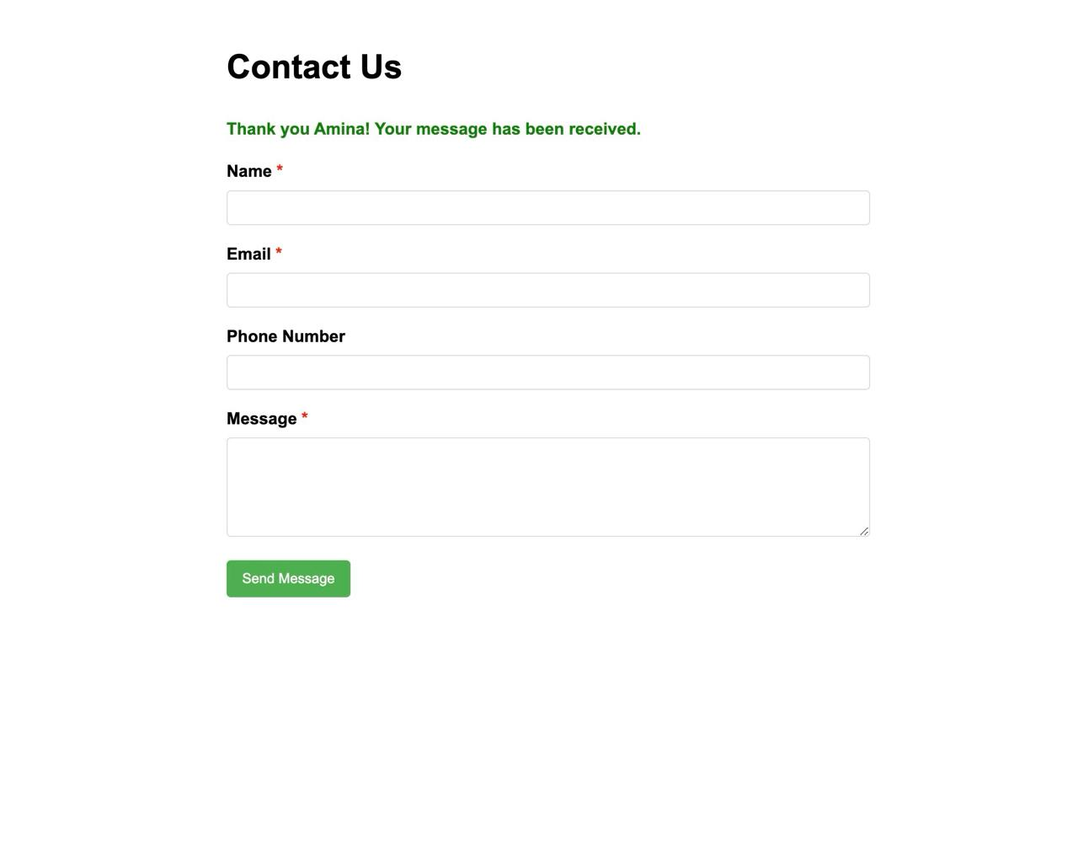
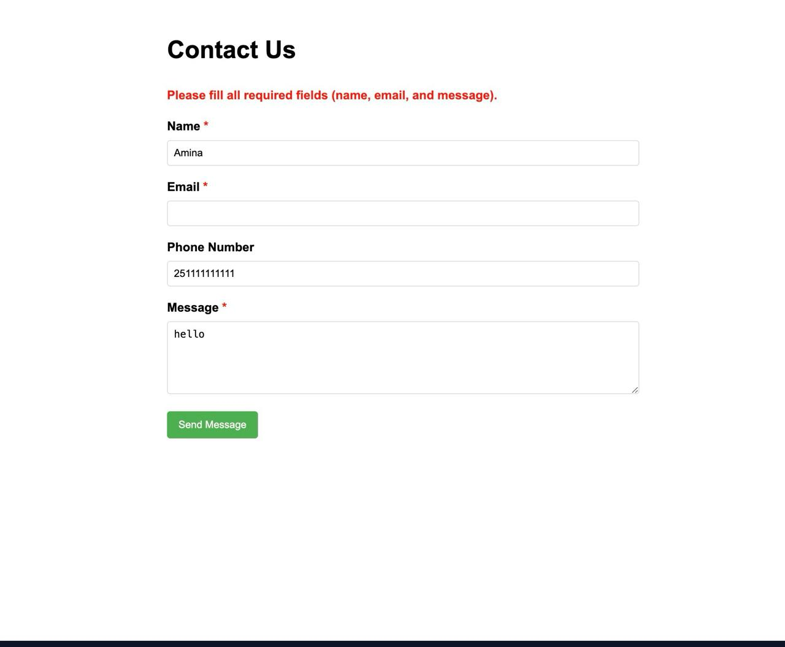

Slide 18
PHP Form Validation
Form validation is a crucial step that needs to be completed before submitting data to the database.
This process is performed to prevent any errors or faulty data from being inserted into the database.
The HTML form includes various input fields such as email, text, checkbox, radio button, etc.
These input fields must be validated to ensure that the user enters only the intended values and not incorrect ones.

Slide 19
String Validation
String validation is the process of checking whether a given string (a sequence of characters) meets specific rules or criteria.
These rules can include format, length, allowed characters, and patterns.
Common Use Cases for String Validation:
User Input Validation – Ensure fields like names, emails, and phone numbers follow the correct format.
Security – Prevent malicious input such as SQL injection and cross-site scripting (XSS).
Data Integrity – Ensure consistency and correctness in databases (e.g., validating dates, IDs).
Form Submission – Validate fields before allowing a user to submit a form.
System Integration – Ensure incoming data from other systems meets your system’s requirements.
Notes:
// To check that User Name only contains alphabets, numbers, and underscores

Slide 20
Empty Field Validation
This is used to check if user has added any data in the required input field. Here, empty() is used to check if a variable is empty or not.
if (empty($_POST["UserName"]))
{ $errorMsg = "User Name is required"; }
else
{ $userName = input_data($_POST["UserName"]);
}
Notes:
Validating that the user name is added or not
// If username is added, we can use it for further use

Slide 21
String Matching
This is used to check if user has added valid string in the required input field. Here, preg_match() is used for pattern matching.
$userName = $_POST["userName"]; if (!preg_match("/^[a-zA-Z0-9_]*$/", $userName))
{ $errorMsg = "Only alphabets, numbers, and underscores are allowed for User Name"; }
Else
{ echo $userName;
}
Notes:
// To check that User Name only contains alphabets, numbers, and underscores

Slide 22
Number Validation
Number validation in an HTML form ensures that users enter valid numeric input in a form field.
HTML provides built-in attributes and methods to validate numbers without requiring JavaScript.
Attribute | Description | Example
min | Minimum value allowed. | <input type="number" min="1">
max | Maximum value allowed. | <input type="number" max="100">
step | Defines the interval between valid values. | <input type="number" step="5">
required | Ensures the field is mandatory. | <input type="number" required>
value | Sets a default number. | <input type="number" value="10">
pattern | Defines a custom regex pattern (for <input type="text">). | <input type="text" pattern="[0-9]+" required>
Notes:
// To check that Phone No is well-formed

Slide 23
Number Validation...
The following example checks whether user has added only numbers in the required input field.
$age = $_POST["age"]; if (!preg_match("/^[0-9]*$/", $age))
{ $errorMsg = "Only numeric values are allowed!!"; }
Else
{ echo $age; }
Notes:
// To check that Phone No is well-formed

Slide 24
Email Validation
This is used to check if user has added a valid email in the required input field.
$emailID = $_POST["emailID"];
$pattern = "^[_a-z0-9-]+(\.[_a-z0-9-]+)*@[a-z0-9-]+(\.[a-z0-9-]+)*(\.[a-z]{2,3})$^"; if (!preg_match($pattern, $emailID) )
{ $errorMsg = "Invalid Email ID format"; }
Else
{ echo $emailID; }
Notes:
// This pattern is standard for email validation
// To check that the e-mail address is well-formed

Slide 25
Count length
This is used to check if the length of the string is in valid range. Here, strlen() is used to find the length of the string.
$phoneNo = $_POST["phoneNo"];
if (strlen($phoneNo) != 10)
{ $errorMsg = "Please provide a phone number of 10 digits!!"; }
Else
{ echo $phoneNo; }
Notes:
// To check that length of Phone Number length should not be less and greator than 10

Slide 26
URL Validation
This is used to check if user has added a valid URL in the required input field.
$url = $_POST["url"]; $pattern = "/\b(?:(?:https?|ftp):\/\/|www\.)[-a-z0-9+&@#\/%?=~_|!:,.;]*[-a-z0-9+&@#\/%=~_|]/i" if (!preg_match($pattern, $url))
{ $errorMsg = "You entered an INVALID URL"; }
else
{ echo $url; }
Notes:
// This pattern is standard for URL validation
// To check that URL address syntax is valid

Slide 27
Sending Values to a Script Manually
There are two different ways you can pass variables and values to a PHP script, both worth knowing.
The first is to make use of HTML's hidden input type:
The second method is to append a value to the PHP script's URL:
www.dmcinsights.com/page.php?name=Brian
<input type="hidden" name="name" value="Brian” />
Notes:
As long as this code is anywhere between the form tags, the variable $_POST['name'] will have a value of Brian in the handling PHP script (assuming that the form uses the POST method).
This technique emulates the GET method of an HTML form. With this specific example, page.php receives a variable called $_GET['name'] with a value of Brian.

Slide 28
PHP Regular Expressions
A regular expression is a sequence of characters that forms a search pattern.
A regular expression can be a single character, or a more complicated pattern.
Regular expressions can be used to perform all types of text search and text replace operations.
Syntax:
$exp = "/win/i";
Notes:
When you search for data in a text, you can use this search pattern to describe what you are searching for.
In the example above, / is the delimiter, w3schools is the pattern that is being searched for, and i is a modifier that makes the search case-insensitive.
The delimiter can be any character that is not a letter, number, backslash or space. The most common delimiter is the forward slash (/), but when your pattern contains forward slashes it is convenient to choose other delimiters such as # or ~.

Slide 29
Regular Expression Functions
The most common expression functions are
Function | Description
preg_match() | Returns 1 if the pattern was found in the string and 0 if not
preg_match_all() | Returns the number of times the pattern was found in the string, which may also be 0
preg_replace() | Returns a new string where matched patterns have been replaced with another string

Slide 30
Using preg_match()
Using preg_match_all()
$str = "Don’t trouble trouble unless it troubles you ";
$pattern = "/rou/i";
echo preg_match_all($pattern, $str);
$str = "Visit LinkedIn";
$pattern = "/LinkedIn/i";
echo preg_match($pattern, $str);
Using preg_replace()
$str = "Visit LinkedIn!";
$pattern = "/LinkedIn/i";
echo preg_replace($pattern, “Instagram", $str);
Notes:
The preg_match() function will tell you whether a string contains matches of a pattern.
The preg_match_all() function will tell you how many matches were found for a pattern in a string.
The preg_replace() function will replace all of the matches of the pattern in a string with another string.

Slide 31
Regular Expression Modifiers
Modifier | Description
i | Performs a case-insensitive search
m | Performs a multiline search (patterns that search for a match at the beginning or end of a string will now match the beginning or end of each line)
u | Enables correct matching of UTF-8 encoded patterns

Slide 32
Regular Expression Patterns
Expression | Description
[abc] | Find one or many of the characters inside the brackets
[^abc] | Find any character NOT between the brackets
[a-z] | Find any character alphabetically between two letters
[A-z] | Find any character alphabetically between a specified upper-case letter and a specified lower-case letter
[A-Z] | Find any character alphabetically between two upper-case letters.
[123] | Find one or many of the digits inside the brackets
[0-5] | Find any digits between the two numbers
[0-9] | Find any digits

Slide 33
Metacharacters
Metacharacter | Description
| | Find a match for any one of the patterns separated by | as in: cat|dog|fish
. | Find any character
^ | Finds a match as the beginning of a string as in: ^Hello
$ | Finds a match at the end of the string as in: World$
\d | Find any digits
\D | Find any non-digits
\s | Find any whitespace character
\S | Find any non-whitespace character
\w | Find any alphabetical letter (a to Z) and digit (0 to 9)
\W | Find any non-alphabetical and non-digit character
\b | Find a match at the beginning of a word like this: \bWORD, or at the end of a word like this: WORD\b
\uxxxx | Find the Unicode character specified by the hexadecimal number xxxx
Notes:
Metacharacters are characters with a special meaning:

Slide 34
Quantifiers
Quantifier | Description
n+ | Matches any string that contains at least one n
n* | Matches any string that contains zero or more occurrences of n
n? | Matches any string that contains zero or one occurrences of n
n{3} | Matches any string that contains a sequence of 3 n's
n{2, 5} | Matches any string that contains a sequence of at least 2, but not more that 5 n's
n{3,} | Matches any string that contains a sequence of at least 3 n's

Slide 35
Takeaway Questions
Write a PHP script that checks if a string contains another string.
Write a PHP script that removes the last word from a string.
Sample string : 'The quick brown fox‘
Expected Output : The quick brown
3. Write a PHP script that removes the whitespaces from a string.
Sample string : 'The quick " " brown fox' Expected Output : Thequick""brownfox

